Slide 1
Predicting customer buying behaviour
Task 2

Slide 2
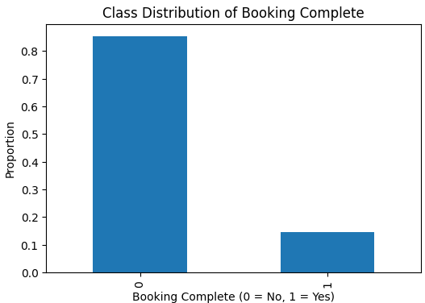
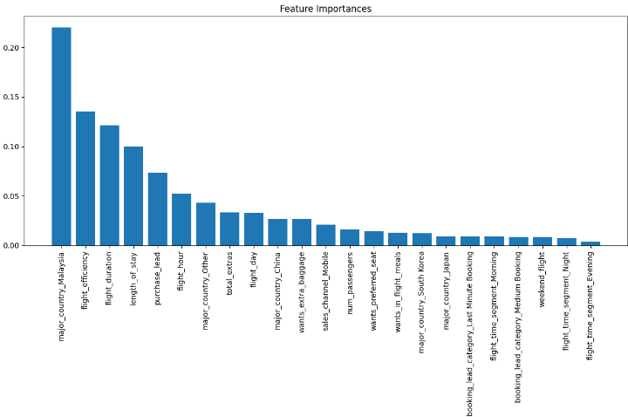
Key information – Imbalaced Dataset
Random Forest Model:
Classifications’ Balanced Accuracy ~ 70%
To improve model performance:
  Handle Outliers: Detect and remove outliers to improve data quality.
  Feature Engineering: Create new or refine existing features to capture patterns better.
  Stratified Train Set: Ensure a balanced distribution of classes in training data to improve learning.
  Threshold Tuning (ROC AUC): Adjust the decision threshold to balance precision and recall for better prediction.

